Slide 1
Chapter 15. Convolutional neural network

Slide 2
Convolutional neural network
https://www.youtube.com/watch?v=f0t-OCG79-U

Slide 3
Motivation

Slide 4
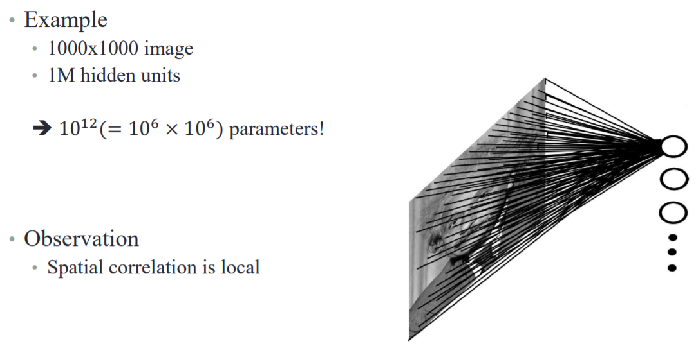
Fully connected neural network

Slide 5
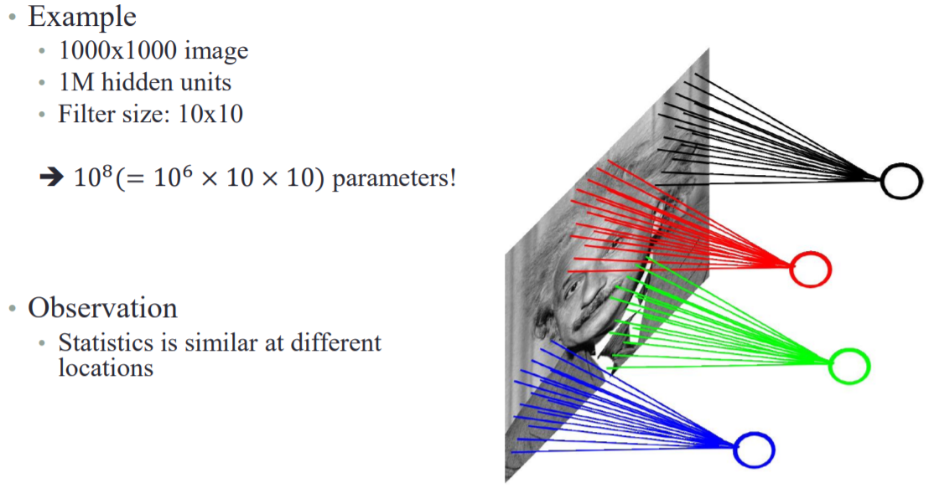
Locally connected neural network

Slide 6
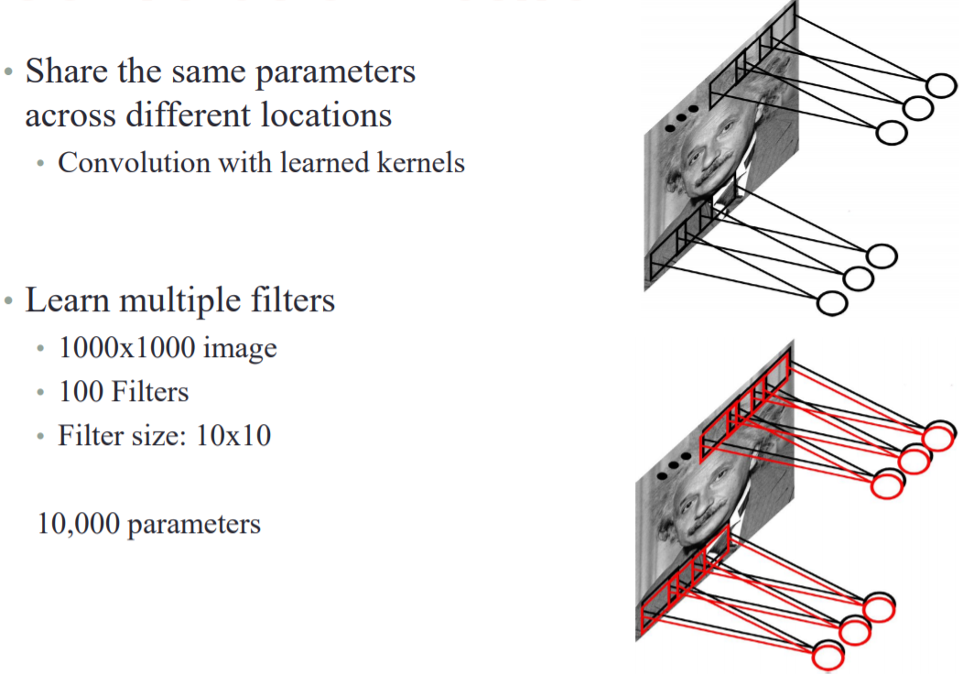
Convolution network

Slide 7
Convolution

Slide 8

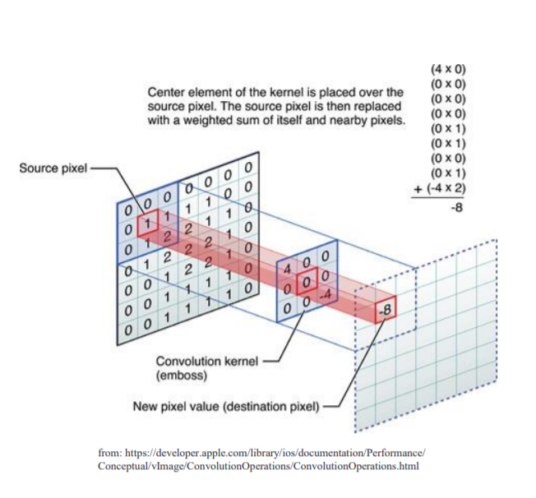
Convolution (Computer vision task)
Element wise multiplication and summation

Slide 9
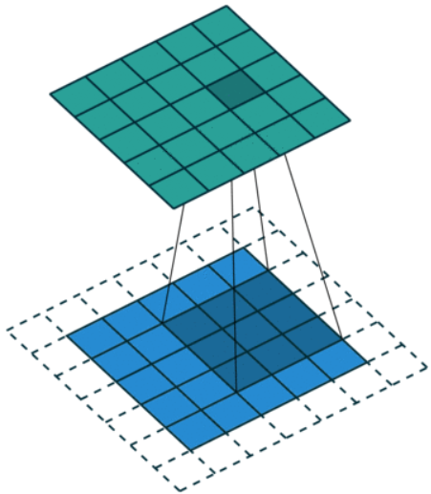
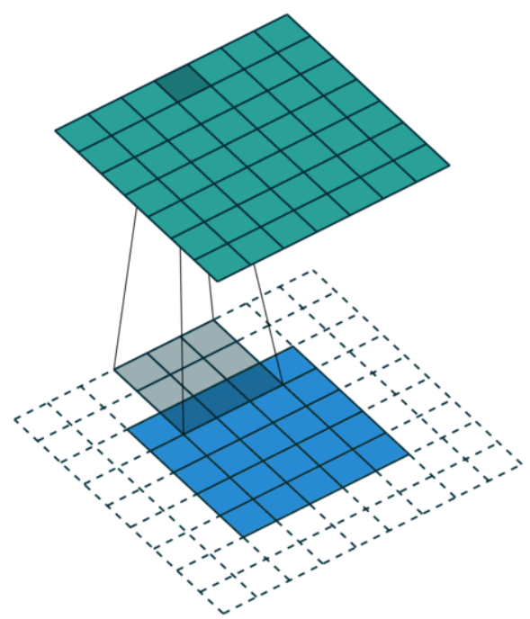
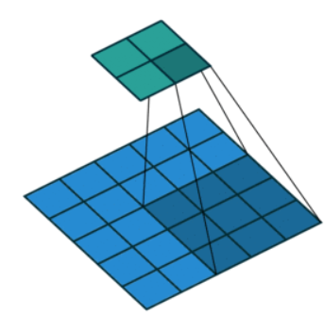
Convolution: padding
Zero padding
Full padding
Valid padding

Slide 10
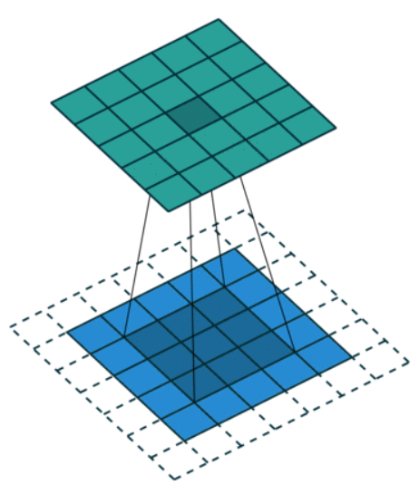
Convolution: stride
Stride = 1

Slide 11
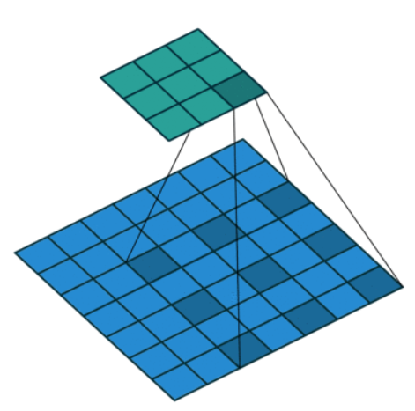
Convolution: dilation rate
Dilation rate = 2

Slide 12
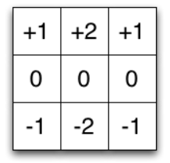
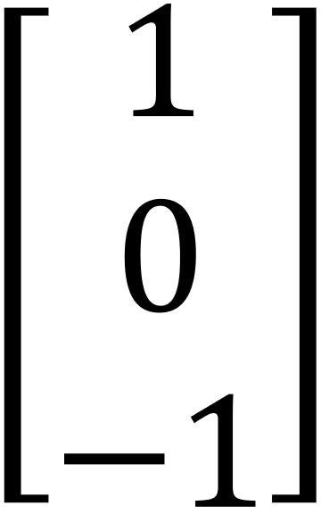

Separable convolution
# of parameters: 9→6

Slide 13
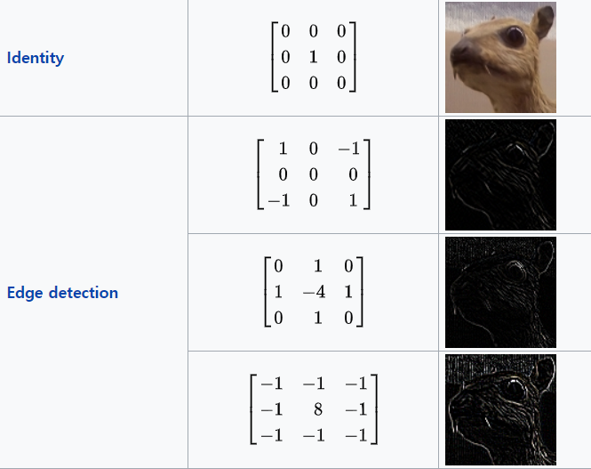
Convolution: application

Slide 14
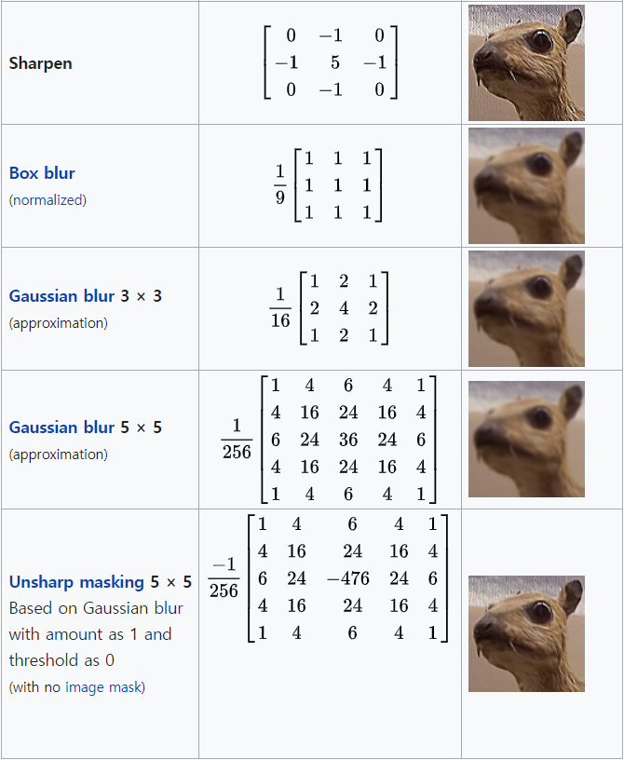
Convolution: application

Slide 15
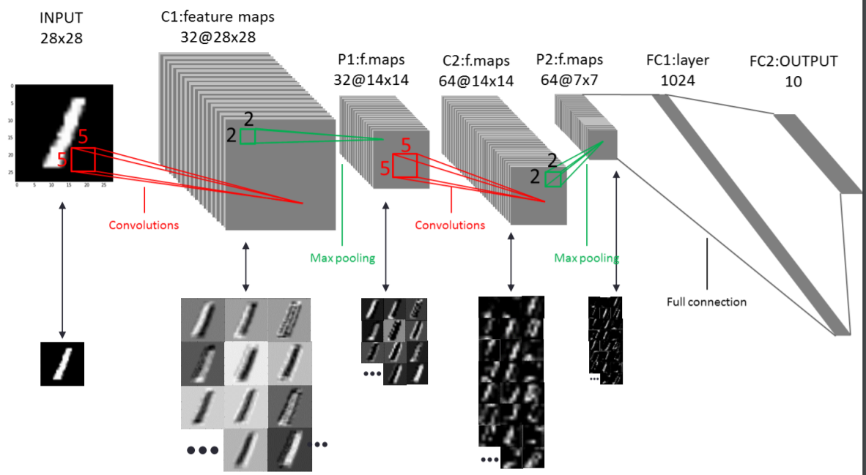
Convolutional neural network: LeNet

Slide 16
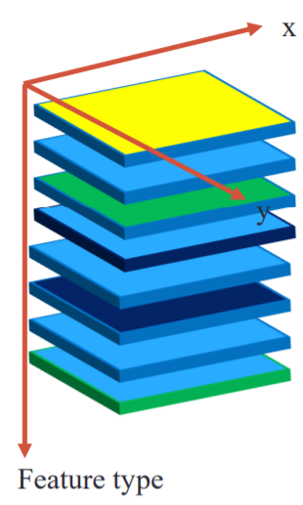
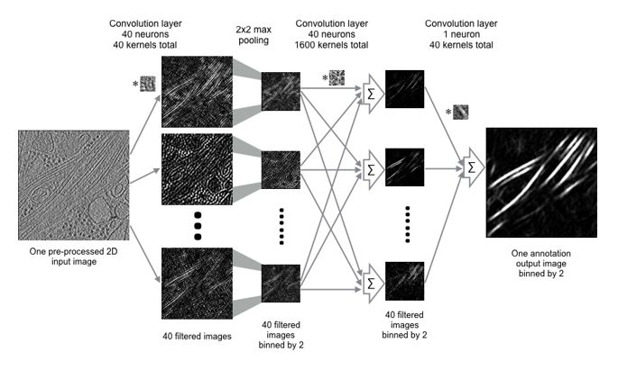

Feature map
Filters
Feature map

Slide 17
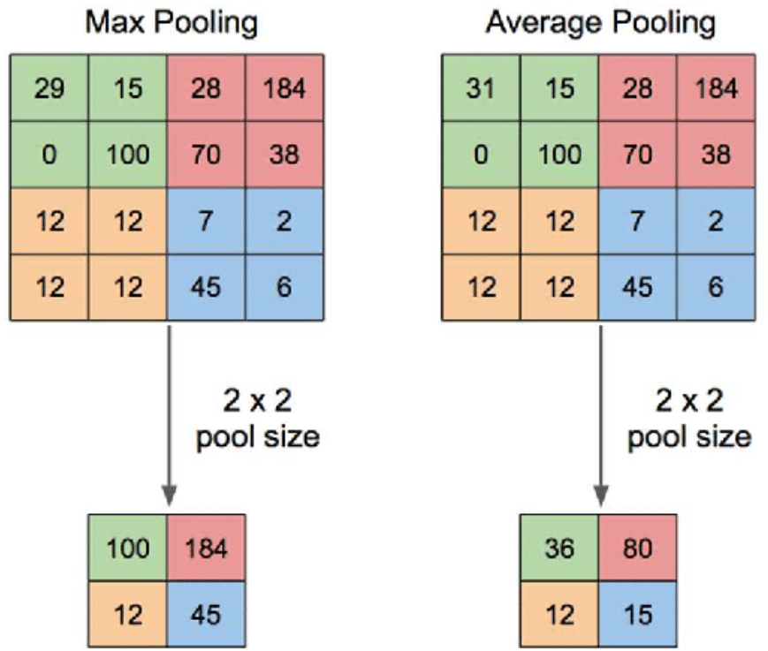
Subsampling (Pooling)

Slide 18
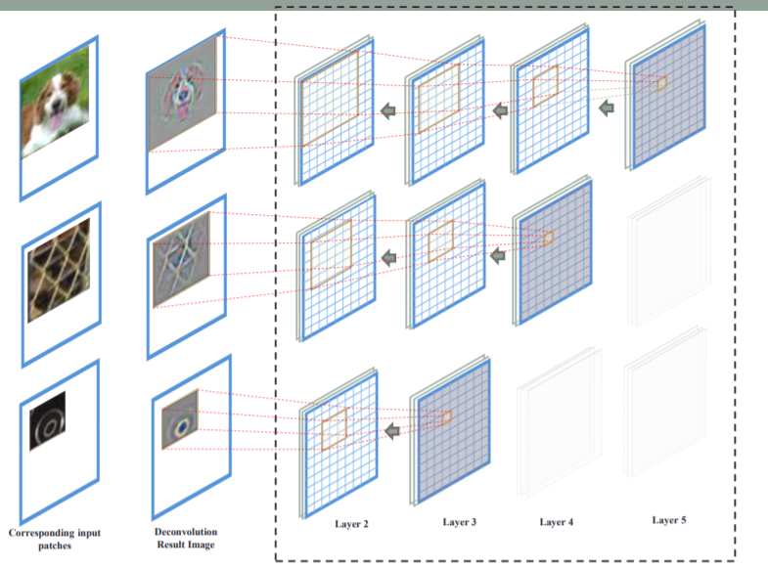
Receptive field
Receptive field

Slide 19
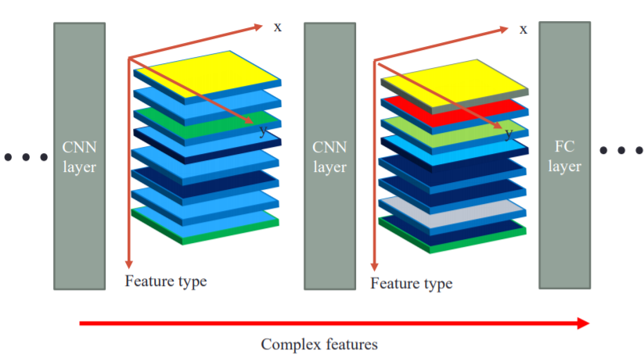
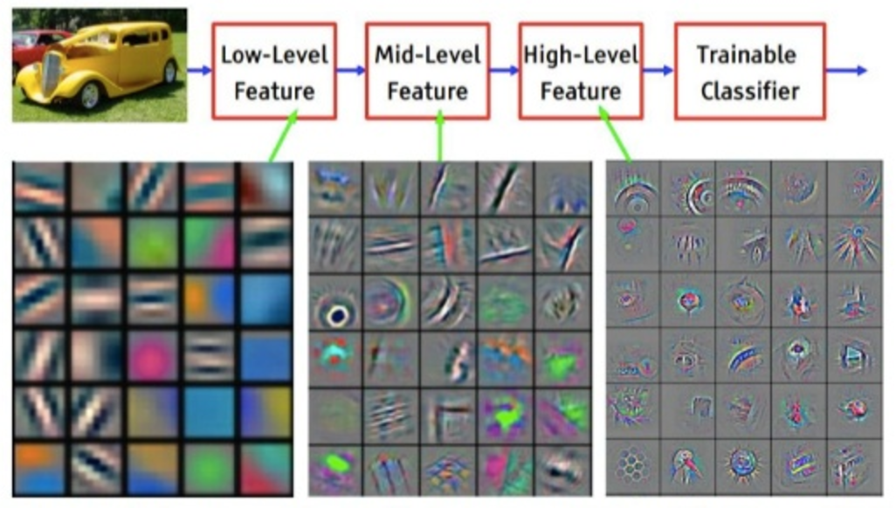
Receptive field: Feature type

